Slide 1


Boomilever
Division B/C
Georgia Tech Event Workshop Series 2024-25

Slide 2
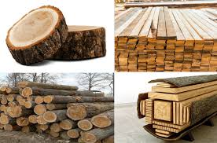
01
RULES SHEET
02
MATERIALS + PHYSICS
[Event-Related Image]
03
COMMON DESIGNS
04
TIPS FROM A VETERAN
05
OTHER FREE RESOURCES
Notes:
For Builds: Replace difficult topics with physical principles involved in the build and replace common questions with common designs

Slide 3
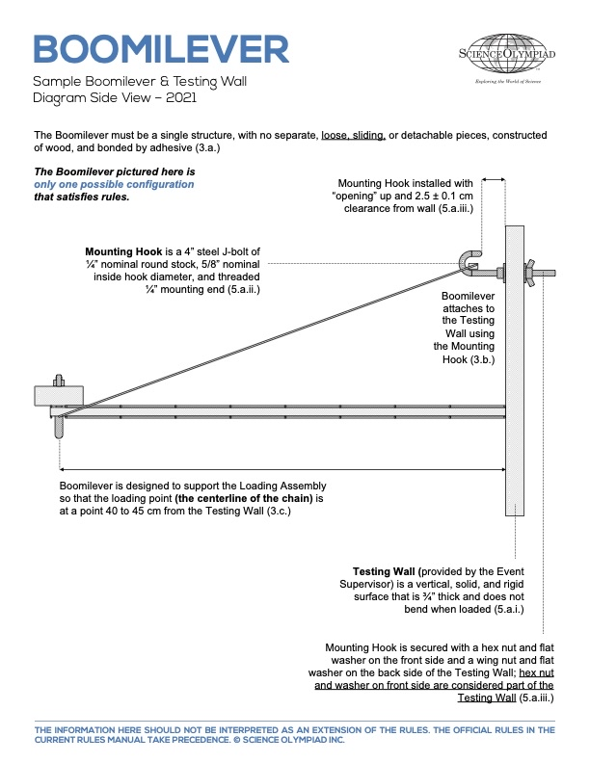
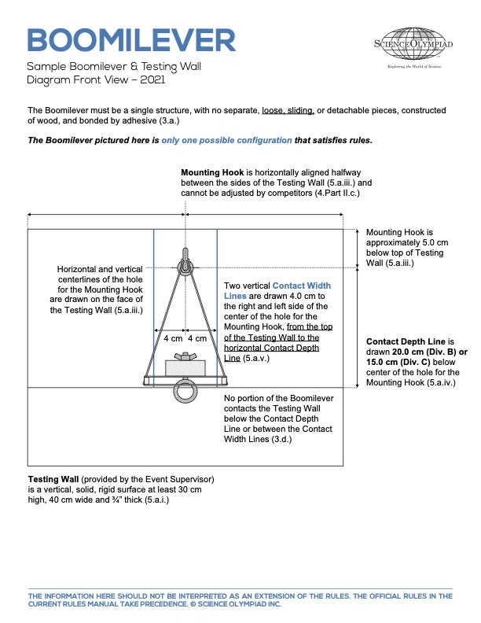
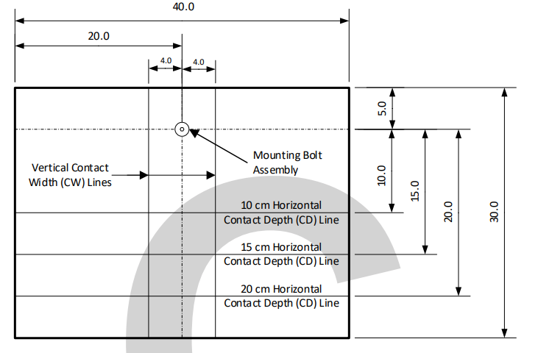
The Rules Sheet
Both Division
Only made from wood and any adhesive
MIDDLE of block 40-45 cm away from wall
Scoring = (Weight held + bonus)/ weight of boomilever
Division B
20 cm non-bonus
15 cm bonus
Between 4 cm lines
Division C
15 cm non-bonus
10 cm bonus
Outside 4 cm lines
Notes:
Highlight key points from the rules sheet: DESIGN LOGS that basically grant free points, most tested-on topics, point distribution so that competitors know what to prioritize, allowed notes and equipment, etc.

Slide 4


Materials +
Physics (very fun)
Notes:
This section should focus on topics that are more math-based (harder to self-teach), concepts that come only usually up in college level courses, or concepts that you struggled with when you competed in this event

Slide 5
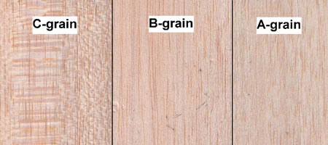
Topic 1: Balsa and Bass Wood
Balsa Wood
Density varies a ton on the lower ends 5-15 lbs/ft^3
Good for compression
Bass Wood
Density varies very little on the higher ends 25-35 lbs/ft^3
Good for tension

Slide 6
Topic 2: Adhesives
Ca glue brands
Bobsmith (my favorite), loctite, and sunbelt
Set quickly
Different viscosity: super thin, thin, medium, and thick
Wood glue
Stronger but heavier
Takes a bit to set
Epoxy
Very strong
Takes a bit to set
Can be toxic

Slide 7
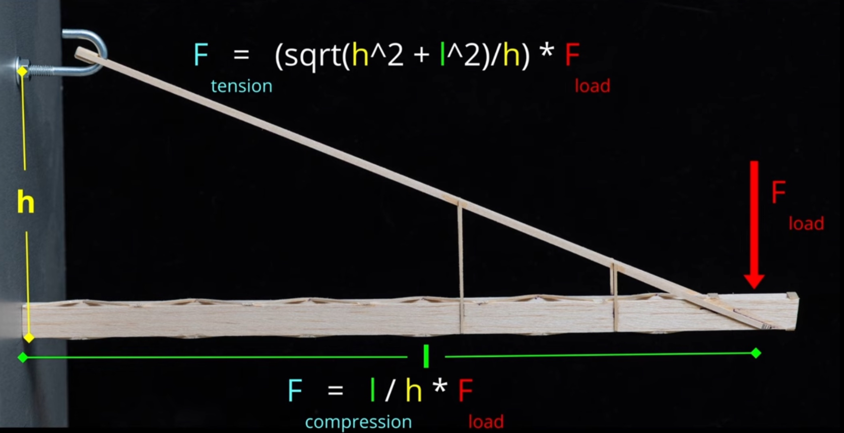
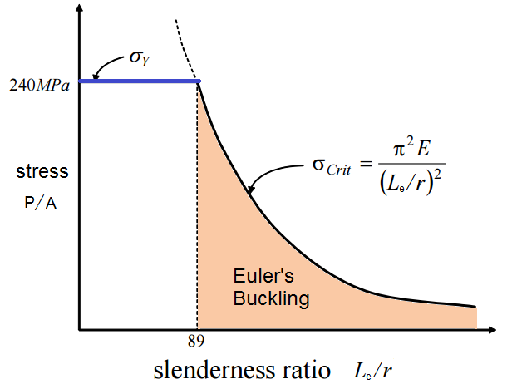
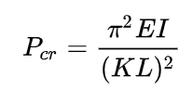
Topic 3: forces + Euler’s
Division B
20 cm 29.1 kg tension 27.3 kg compression
15 cm 43.7 kg tension 41 kg compression
Division c
15 cm 43.7 kg tension 41 kg compression
10cm 63.3 kg tension 61.5 kg compression
Euler’s Critical Load Law
Essentially at half the length 4x the buckling strength
Notes:
Feel free to add more topics and make sure that there are plenty of pictures/diagrams!

Slide 8


COMMON
Designs
Notes:
\

Slide 9
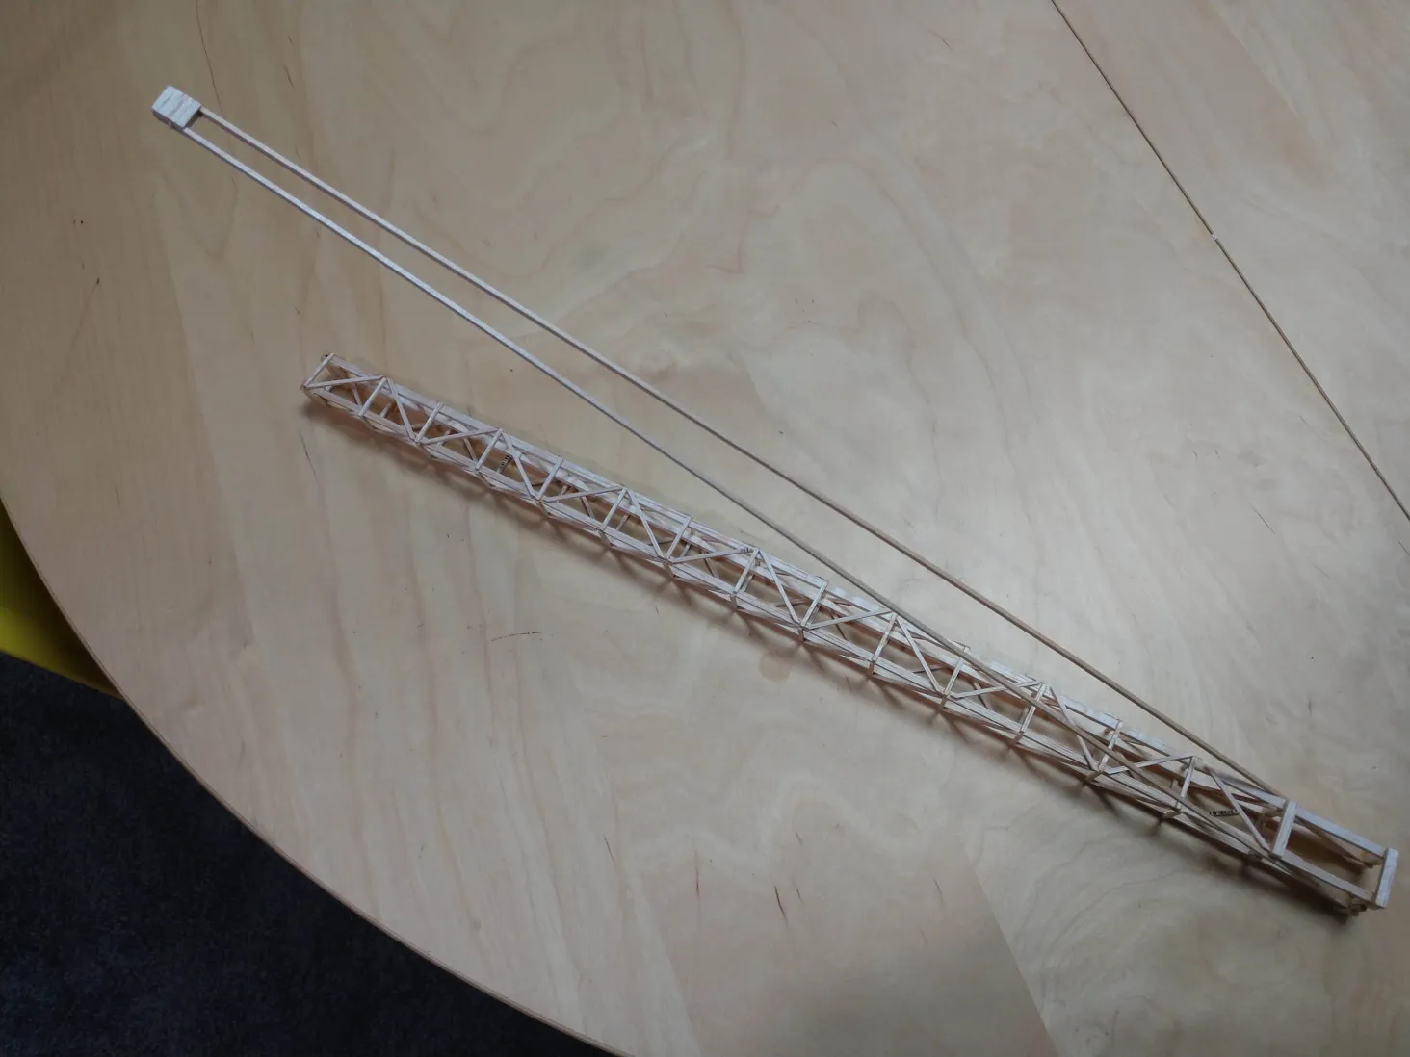
Division B Design 1
Compression
Sides 1/8in main beams + 1/16 supports
1/16 crossmembers
Tension
1/16 x 1/16 beam
Unknown bass wood block
Notes:
Pull some questions from exams on the scioly wiki test exchange, first give attendees a couple minutes to read over them/work through them, then walk them through the answers

Slide 10
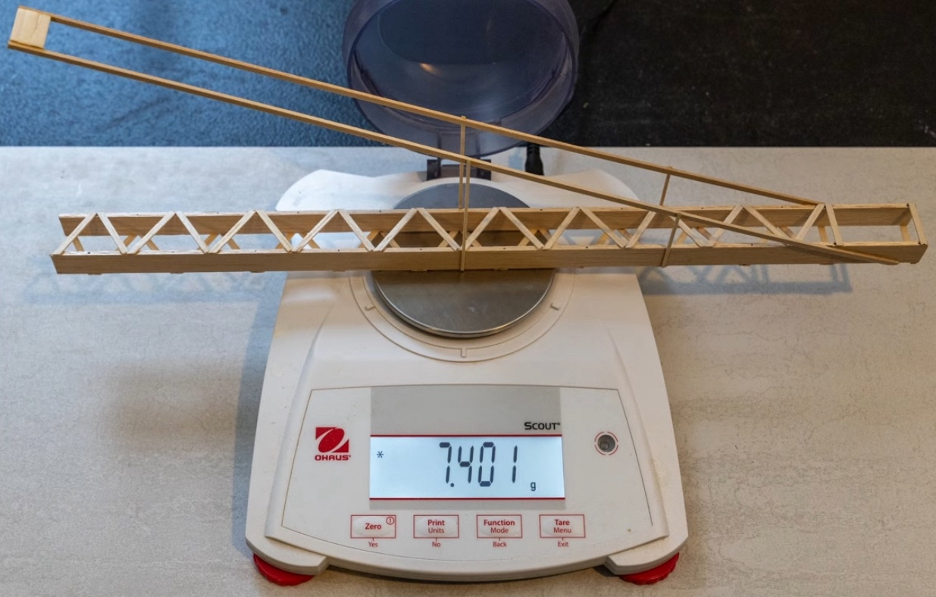
Division B Design 2
Compression
Sides 3/32 x 15mm
1/32 x 2.5mm crossmembers
Tension
1/16 x 3/32 tension beam
3 of 1/8 x 3/16 block
Verticals
1/32 x 1/16
Notes:
Pull some questions from exams on the scioly wiki test exchange, first give attendees a couple minutes to read over them/work through them, then walk them through the answers

Slide 11
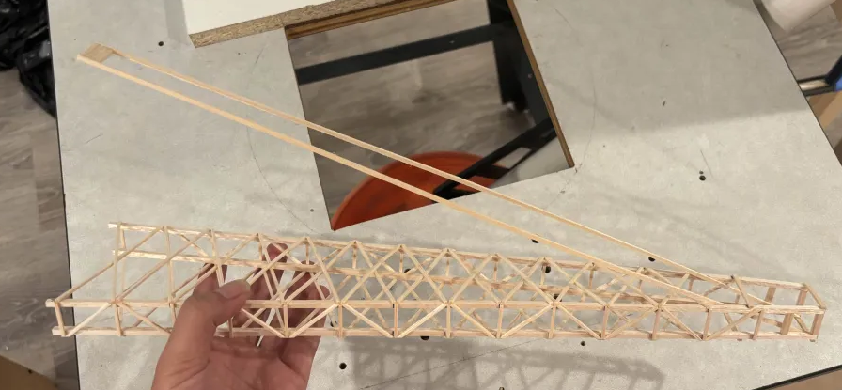
Division C design 1
Compression
Sides 1/8in main beams + 1/16 supports
1/16 crossmembers
Tension
1/16 x 3/32 beam
4 of 1/16 x 3/32
Notes:
Pull some questions from exams on the scioly wiki test exchange, first give attendees a couple minutes to read over them/work through them, then walk them through the answers. Try to get a mix of multiple choice and short answer or matching

Slide 12
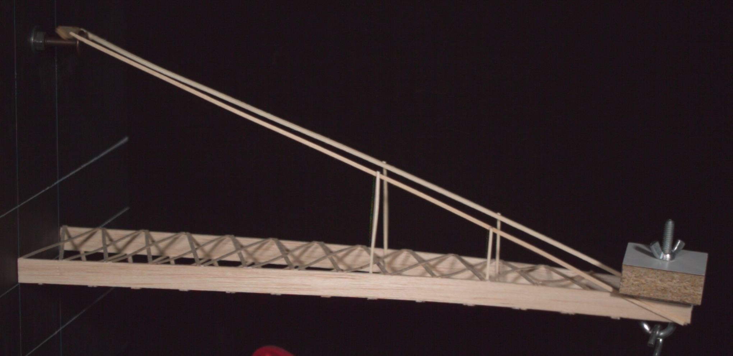
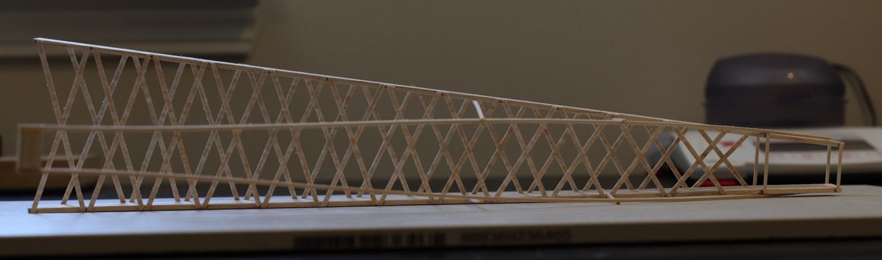
Division C design 2
Compression
Sides 3/32 x 15mm
1/32 x 2.5mm crossmembers
Tension
1/16 x 3/32 beam
3 of 1/8 x 3/16 block
Verticals
1/32 x 1/16
Notes:
Pull some questions from exams on the scioly wiki test exchange, first give attendees a couple minutes to read over them/work through them, then walk them through the answers

Slide 13
Tips from a Veteran
Building and logging
Choosing wood
Make tons of joints
Take measurements of everything and log them
Preparing for competition
Practice setting up the boomilever with someone timing you
Practice handling the boomi
During competition
Ask questions
Calm down
Notes:
Use this section to talk about any strategies you used to navigate the event when you competed. For example, how did you manage your time, how did you organize your notes, how did you split topics up between you and your partner, etc.?

Slide 14

Additional Resources
“Balsa Engineering”
on Youtube
“Science Olympiad Balsa Event Autoloader”
On Youtube
Boomilever Guide
SUBWAY STATIONS
Resource 4
Yes, Saturn is the ringed one. This planet is a gas giant, and it’s composed mostly of hydrogen and helium
Notes:
Here, you can link or mention any online or book resources that helped you in this event when you were a competitor. Try to avoid general resources like scioly wiki, because they probably already are familiar with it.

Slide 15
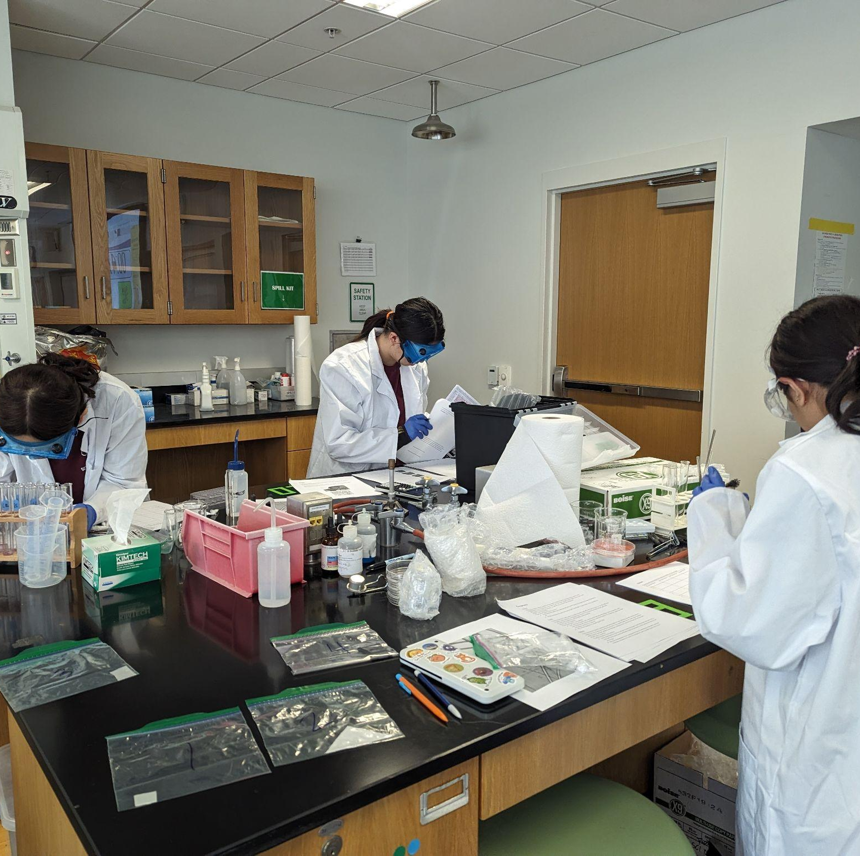
THANKS!
Notes:
(replace picture with a picture from one of our tournaments)

